Slide 1


NTUA Top Tagger Tag & Probe methodology
G. Bakas, K. Kousouris, I. Papakrivopoulos, G. Tsipolitis

Slide 2
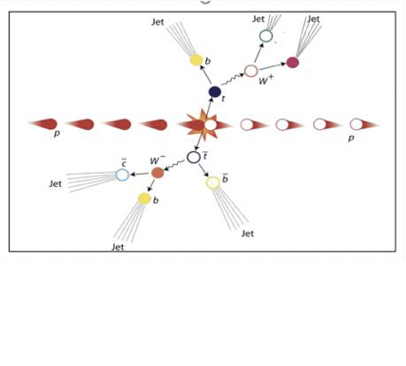
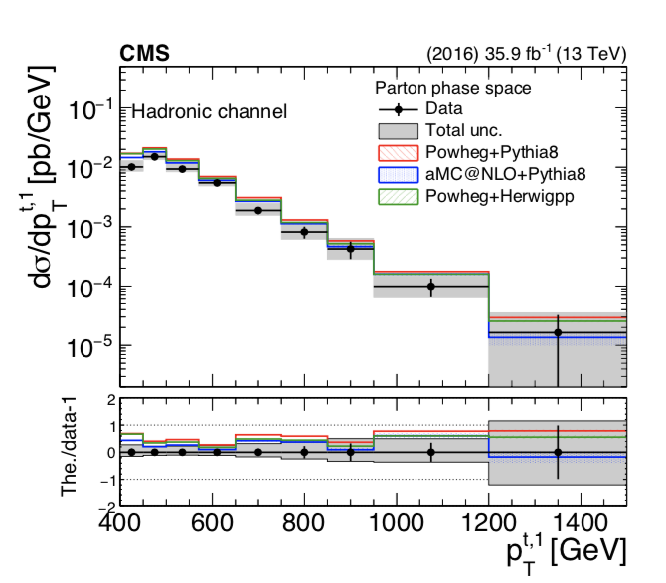
Analysis Overview
Differential cross section for boosted ttbar pair fully hadronic final state
Trying to identify two big jets that contain the products of the top/anti-top decay.
A NN, for tagging ttbar events was used in TOP-18-013
A BDT for tagging jets as tops is used in this analysis
Notes:
We have measured the fraction of events used in the cross section measurement that are also
669 used for the SF measurement to be of the order of 35% (due to phase-space differences and
670 randomization in the SF measurement). We consider that this fraction is reasonably small.

Slide 3
Signal Selection
Control Region Selection
Variables | Selected Cut
pT leading jets | > 450 GeV
pT 2nd leading jets | > 400 GeV
Njets | > 1
N leptons | = 0
|eta| (both leading jets) | < 2.4
mJJ | > 1000 GeV
jetMassSoftDrop (only for fit) | (50,300) GeV
Top Tagger | > 0.2
B tagging (2 btagged jets) | > Medium WP
Signal Trigger
Variables | Selected Cut
pT leading jets | > 450 GeV
pT 2nd leading jets | > 400 GeV
N leptons | = 0
|eta| (both leading jets) | < 2.4
mJJ | > 1000 GeV
jetMassSoftDrop (only for fit) | (50,300) GeV
Top Tagger | > 0.2
B tagging (0 btagged jets) | < Medium WP
Control Trigger

Slide 4
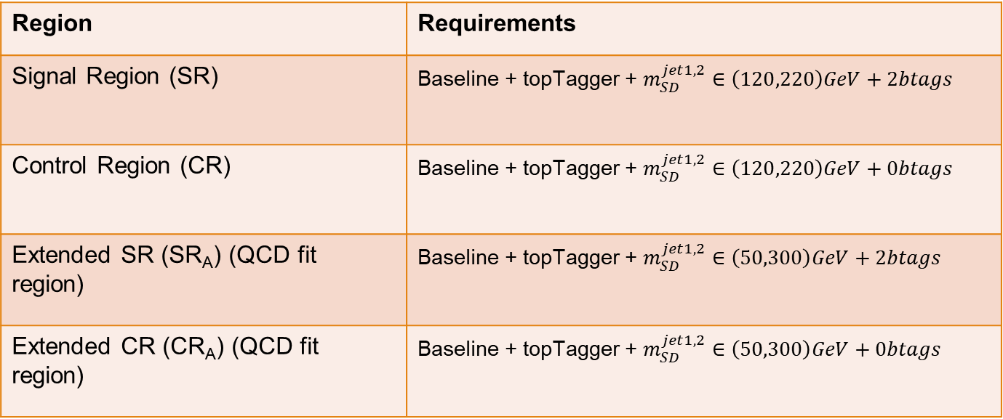
Selection Overview
Region | Requirements
Signal Region (SR) | Baseline + topTagger + $m_{SD}^{jet1,2}∈\left(120,220\right)GeV+2btags$
Control Region (CR) | Baseline + topTagger + $m_{SD}^{jet1,2}∈\left(120,220\right)GeV+0btags$
Extended SR (SR_{A}) (QCD fit region) | Baseline + topTagger + $m_{SD}^{jet1,2}∈\left(50,300\right)GeV+2btags$
Extended CR (CR_{A}) (QCD fit region) | Baseline + topTagger + $m_{SD}^{jet1,2}∈\left(50,300\right)GeV+0btags$

Slide 5
Signal Extraction
Fitted number of QCD events in SR_{A}
Measured dist from data
QCD shape taken from Data (CR)
$$S\left(x_{reco}\right)=D\left(x_{reco}\right)−C_{bkg}^{yield}N_{QCD}^{fit}C_{QCD}^{shape}\left(x_{reco}\right)Q\left(x_{reco}\right)−B(x_{reco})$$
Fiducial Yield
Transfer factor from SR_{A} to SR
QCD shape correction factor
Subdominant bkg shape and contribution (MC)

Slide 6

Signal Extraction
Measured dist from data
QCD shape correction factor
QCD shape from Data
$$S\left(x_{reco}\right)=D\left(x_{reco}\right)−C_{bkg}^{yield}N_{QCD}^{fit}C_{QCD}^{shape}\left(x_{reco}\right)Q\left(x_{reco}\right)−B(x_{reco})$$
Fiducial Yield
Number of QCD events in ${SR}_{A}$
Subdominant bkg contribution (MC)
We deploy a fit in the extended signal region (${SR}_{A}$) to determine the Number of QCD events $N_{QCD}^{fit}$

Slide 7
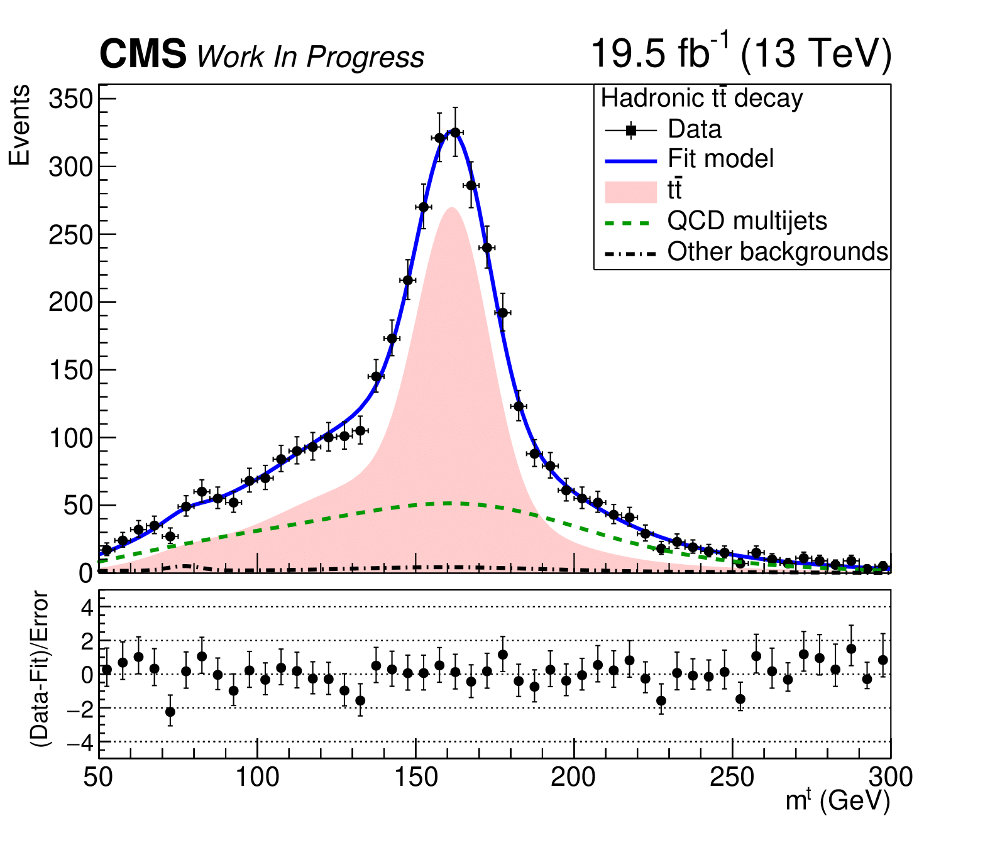
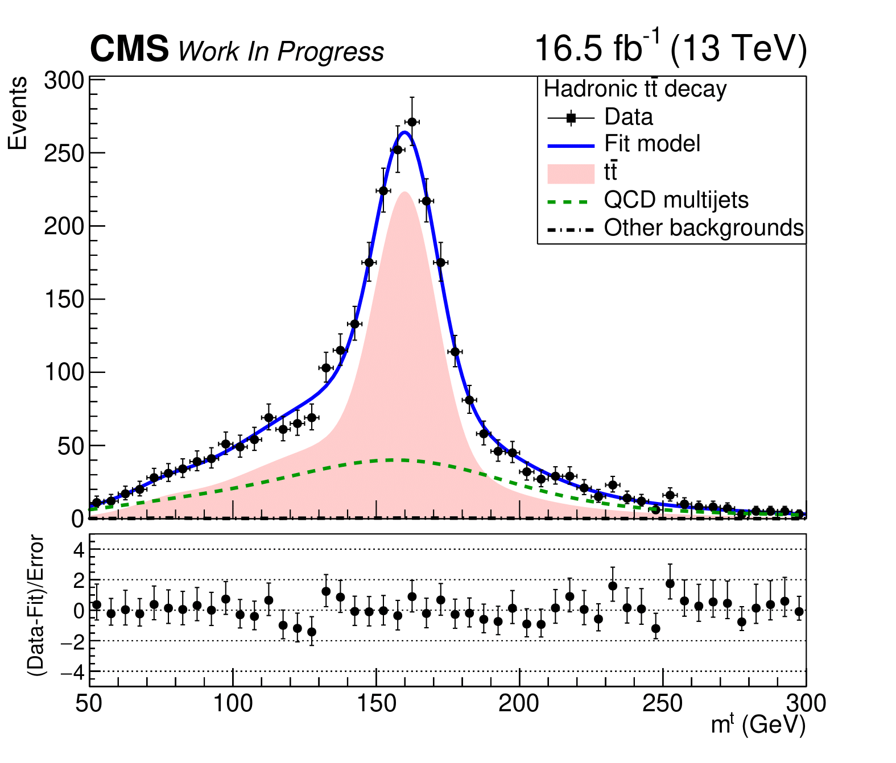


Mass Fit in SR_{A}
2016_postVFP
r = 0.640 ± 0.029
2016_preVFP
r = 0.691 ± 0.028
2017
r = 0.665 ± 0.018
2018
r = 0.675 ± 0.016

Slide 8
Motivation
The main background for this analysis is QCD
A data driven method is used for subtracting it
The method relies on the assumption that by inverting the b-tagging requirement in the signal region (SR) we can have the shape of the QCD contribution
The tagger is required not to use b-tagging information and the full range of the subjet mass
An in-house BDT was developed to overcome this limitation
DeepAK8 uses b-tagging
Older top taggers use jet mass cuts

Slide 9
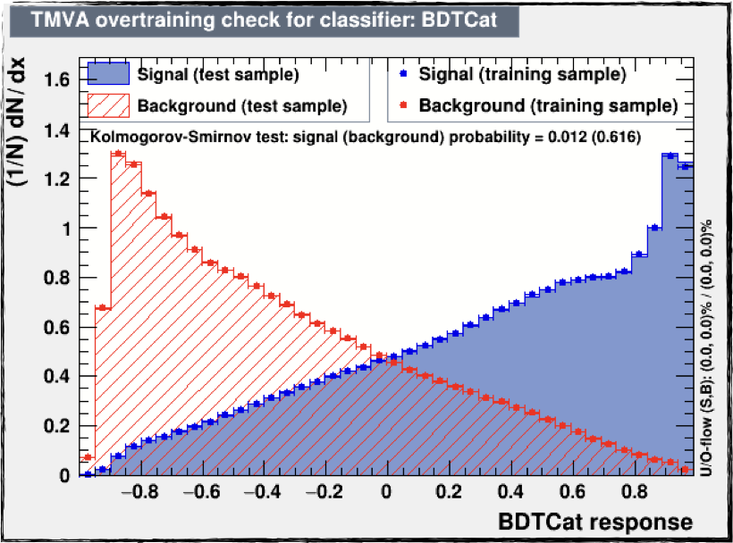
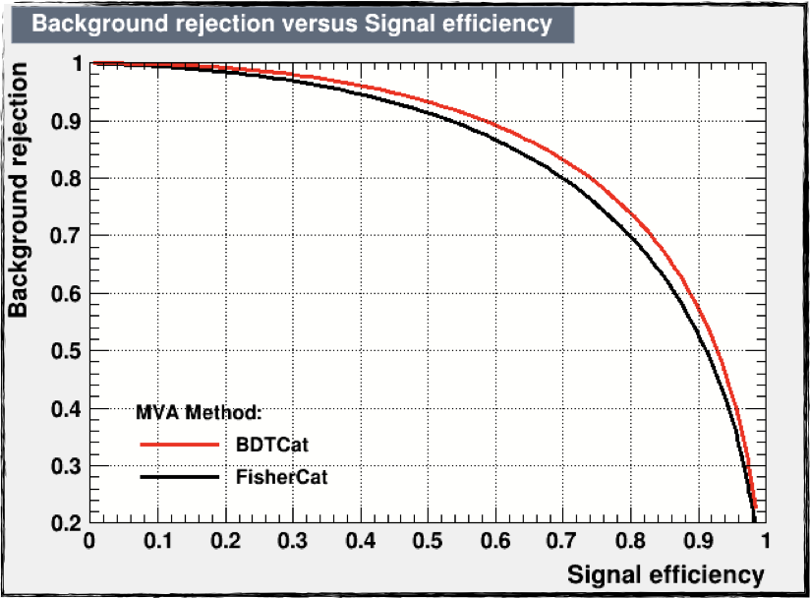
BDT Output
In house developed top tagger, for top candidate jets
BDT based
Input variables:
N-subjetiness: 𝜏1, 𝜏2, 𝜏3
Energy correlation functions (ECF) ECFB1N2, ECFB1N3, ECFB2N2, ECFB2N3
Soft drop mass of the leading and subleading subjets
Fraction of the jet over the of all the jets in the event
No b-tagging requirements
Phase space split in categories based on the pt of the jet:
[400, 600) GeV
[600, 800) GeV
[800, 1200) GeV
[1200, Inf) GeV
Different training and working point for each year (Signal) and QCD (Bkg) samples used in the training
The use of DeepAK8 was investigated but it uses b-tagging so it is not applicable in our use case
2018

Slide 10
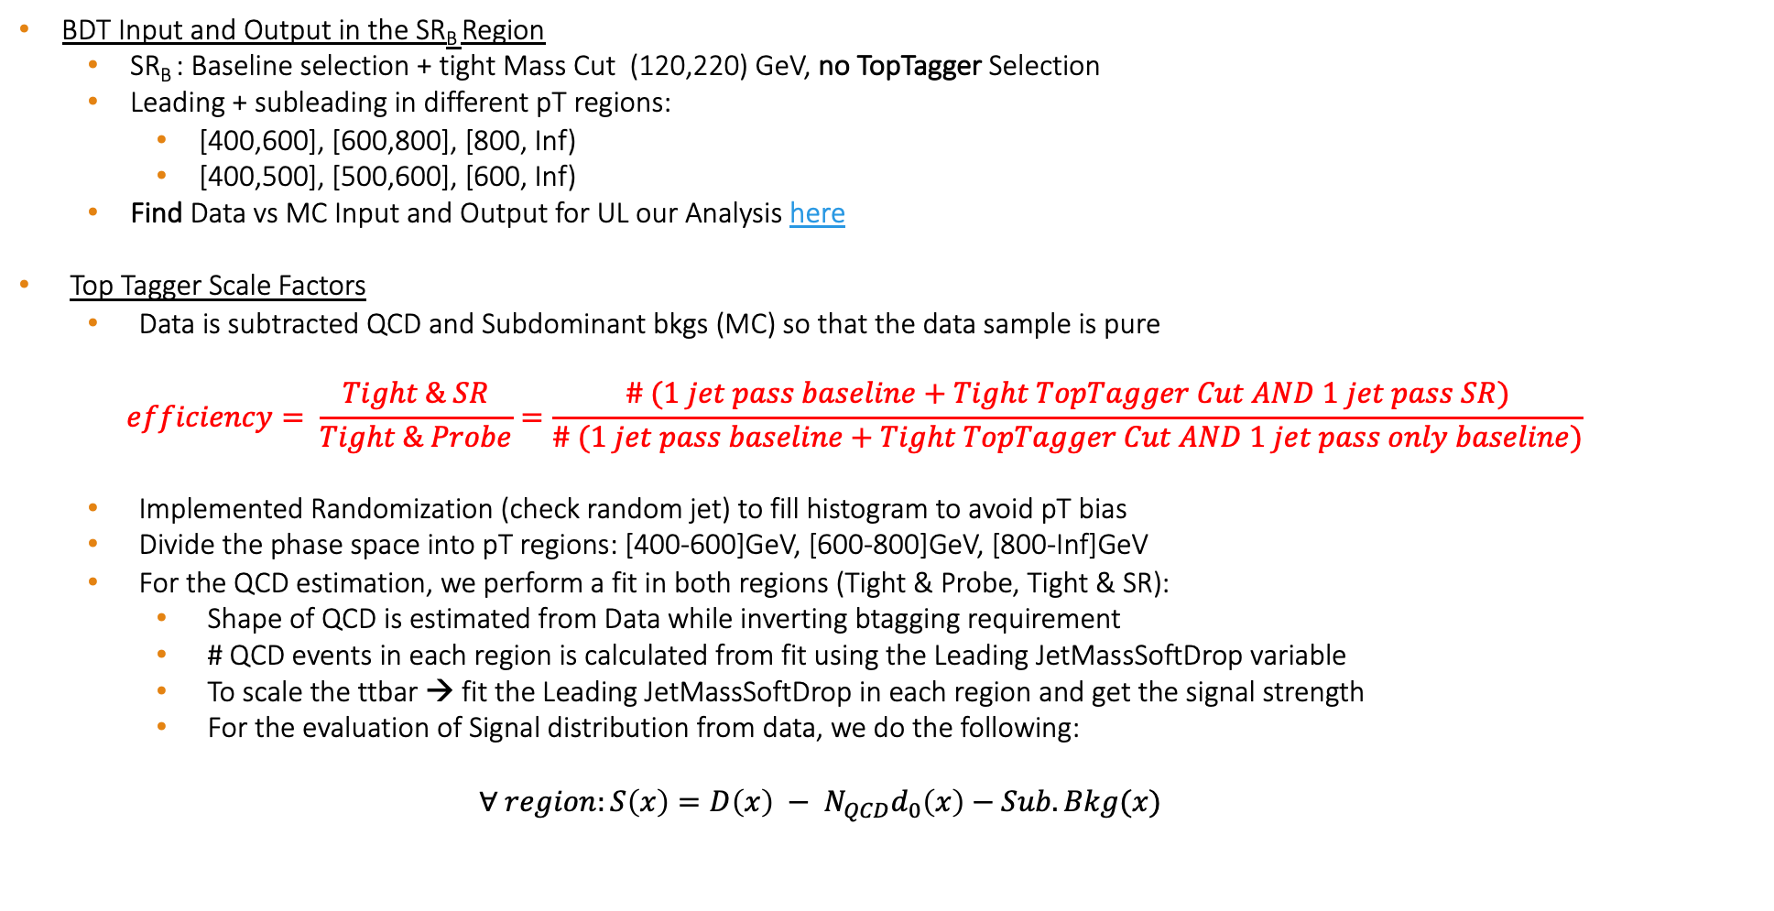
Overview
BDT Input and Output in the SR_{B} Region
SR_{B} : Baseline selection + tight Mass Cut (120,220) GeV, no TopTagger Selection
Leading + subleading in different pT regions:
[400,600], [600,800], [800, Inf)
[400,500], [500,600], [600, Inf)
Find Data vs MC Input and Output for UL our Analysis here
Top Tagger Scale Factors
Data is subtracted QCD and Subdominant bkgs (MC) so that the data sample is pure
$$efficiency= \frac{Tight \& SR}{Tight \& Probe}=\frac{\# (1 jet pass baseline+Tight TopTagger Cut AND 1 jet pass SR)}{\# (1 jet pass baseline+Tight TopTagger Cut AND 1 jet pass only baseline)}$$
Implemented Randomization (check random jet) to fill histogram to avoid pT bias
Divide the phase space into pT regions: [400-600]GeV, [600-800]GeV, [800-Inf]GeV
For the QCD estimation, we perform a fit in both regions (Tight & Probe, Tight & SR):
Shape of QCD is estimated from Data while inverting btagging requirement
# QCD events in each region is calculated from fit using the Leading JetMassSoftDrop variable
To scale the ttbar → fit the Leading JetMassSoftDrop in each region and get the signal strength
For the evaluation of Signal distribution from data, we do the following:
$$∀ region:S\left(x\right)={D\left(x\right) − N}_{QCD}d_{0}\left(x\right)−Sub.Bkg(x)$$
Fraction of events used in the cross section measurement that are also used in the Top Tagger SF measurement is of the order of 35%
Notes:
We have measured the fraction of events used in the cross section measurement that are also
669 used for the SF measurement to be of the order of 35% (due to phase-space differences and
670 randomization in the SF measurement). We consider that this fraction is reasonably small.

Slide 11
Scale Factors
2016 preVFP
2016 postVFP
[400, 600]
[600, 800]
[400, 600]
[600, 800]
[800, Inf)
[800, Inf)
[800, Inf)
[800, Inf)
[400, 600]
[600, 800]
[400, 600]
[600, 800]
2017
2018

Slide 12
Scale Factors
[400, 500]
[600, Inf)
[500, 600]
[400, 500]
2016 preVFP
2016 postVFP
[500, 600]
[600, Inf)
[400, 500]
[500, 600]
[600, Inf)
[500, 600]
[600, Inf)
[400, 500]
2017
2018

Slide 13
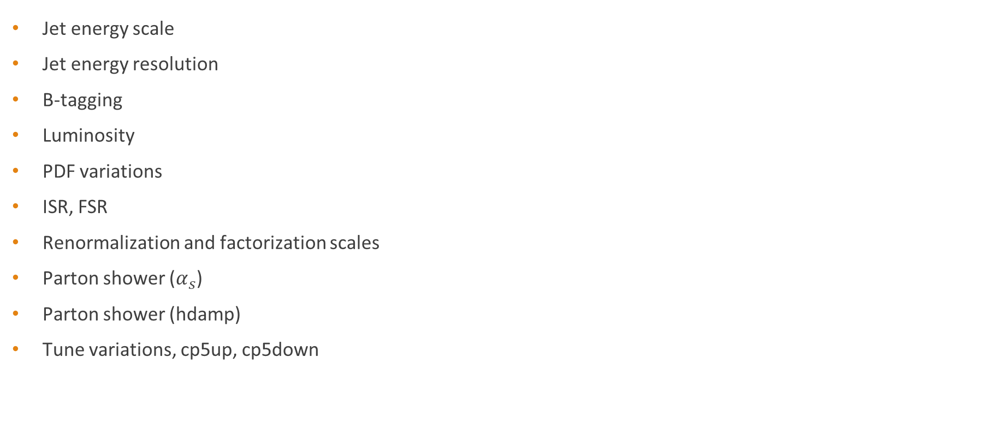
Systematic uncertainties list
Jet energy scale
Jet energy resolution
B-tagging
Luminosity
PDF variations
ISR, FSR
Renormalization and factorization scales
Parton shower ($α_{s}$)
Parton shower (hdamp)
Tune variations, cp5up, cp5down

Slide 14
Combination
Perform the signal extraction for each individual year
The signal extraction is performed for the nominal samples and for each variation separately
For the nominal sample and each variation, add the separate years to form a common signal
Correlations used in the addition of the uncertainties based on the corresponding recommendations from each group
Calculate combined response matrix
Calculate combined efficiency and acceptance
Unfold and calculate cross section for the nominal and each variation separately
Calculate the total systematic uncertainty to produce the final measurement

Slide 15
Systematic Uncertainties Breakdown

Slide 16
Systematic Uncertainties Breakdown

Slide 17
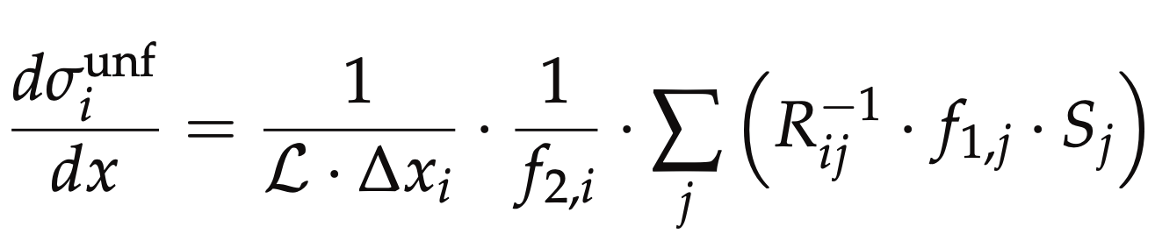
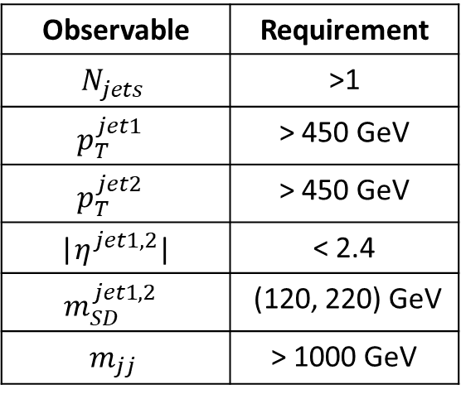
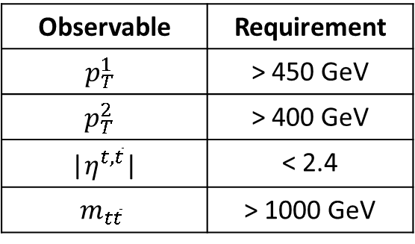
Parton & Particle levels
Particle level
Parton
Observable | Requirement
$$N_{jets}$$ | >1
$$p_{T}^{jet1 }$$ | > 450 GeV
$$p_{T}^{jet2 }$$ | > 450 GeV
|$η^{jet1, 2}$| | < 2.4
$$m_{SD}^{jet1, 2 }$$ | (120, 220) GeV
$$m_{jj}$$ | > 1000 GeV
Observable | Requirement
$$p_{T}^{1 }$$ | > 450 GeV
$$p_{T}^{2 }$$ | > 400 GeV
|$η^{t,\overline{t}}$| | < 2.4
$$m_{t\overline{t}}$$ | > 1000 GeV
Parton Phase space
Reco/Fiducial Phase space
true efficiency of the reco+true selection
reco efficiency of the reco+true selection
migration matrix
Unfolding: simple response matrix inversion w/o regularisation

Slide 18
Final Results (absolute)

Slide 19
Final Results (normalized)

Slide 20
Backup

Slide 21
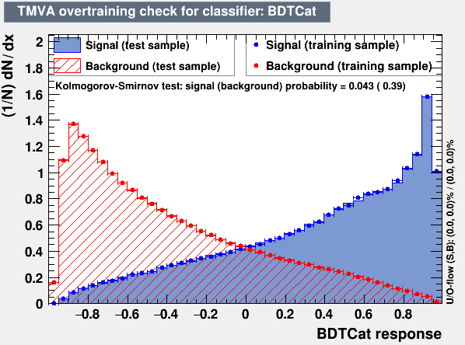
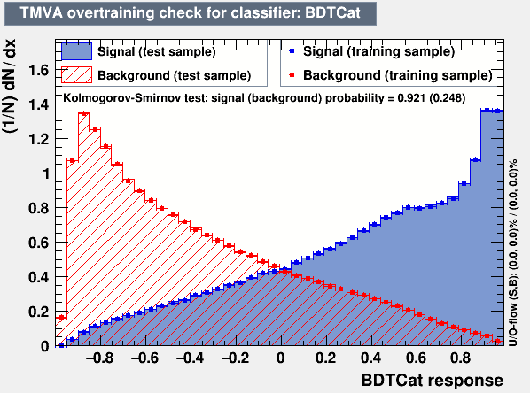

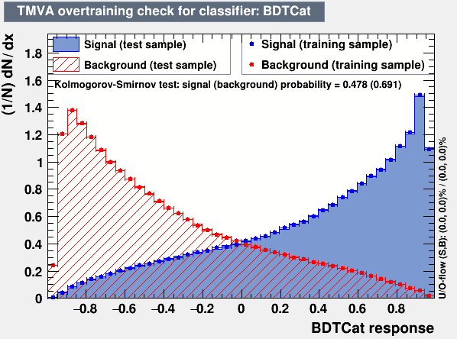
Top Tagger
2016_postVFP
2016_preVFP
2017
2018

Slide 22
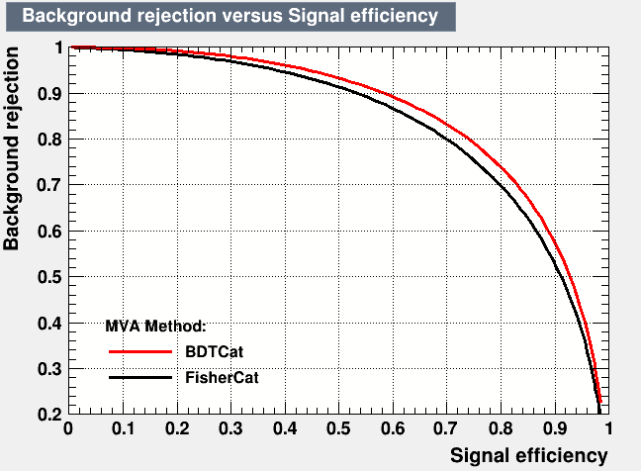
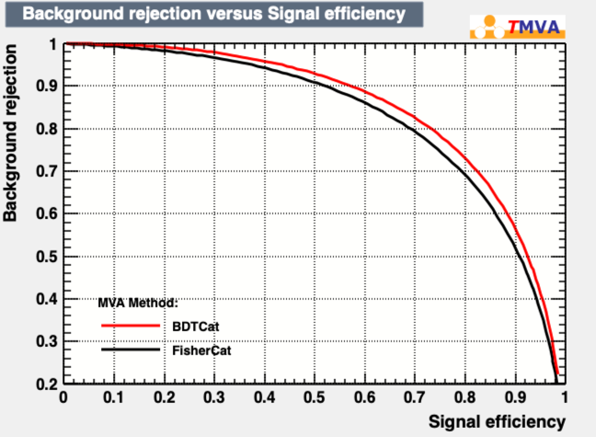

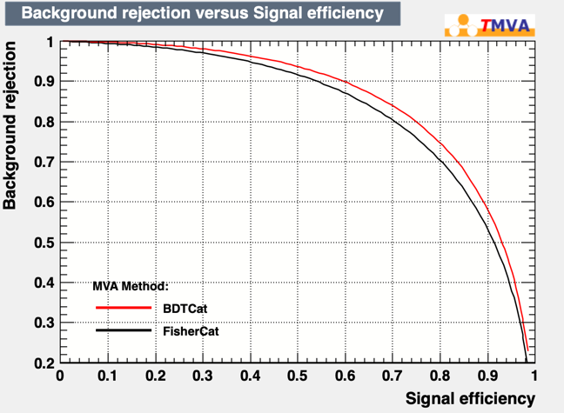
Top Tagger
2016_postVFP
2016_preVFP
2017
2018

Slide 23
Shape Comparison of the probe jet and the jets used for the measurement (double Filled)
2018
Data
MC
Notes:
We have measured the fraction of events used in the cross section measurement that are also
669 used for the SF measurement to be of the order of 35% (due to phase-space differences and
670 randomization in the SF measurement). We consider that this fraction is reasonably small.

Slide 24
Shape Comparison of the probe jet and the jets used for the measurement
2018
Data
MC
Notes:
We have measured the fraction of events used in the cross section measurement that are also
669 used for the SF measurement to be of the order of 35% (due to phase-space differences and
670 randomization in the SF measurement). We consider that this fraction is reasonably small.

Slide 25
Top Tagger Input Variables
2018
Leading jet

Slide 26
Top Tagger Input Variables
2018
Second Leading Jet
NTUA

Slide 27
Top Tagger Output
2018
Leading Jet
Second Leading Jet

Slide 28
Top Tagger Efficiencies

Slide 29
TagAndProbe Efficiency per Pt region
[800, Inf)
[800, Inf)
[600, 800]
[600, 800]
[400, 600]
[400, 600]
2016 preVFP
2016 postVFP
[800, Inf)
[400, 600]
[600, 800]
[600, 800]
[800, Inf)
[400, 600]
2017
2018

Slide 30
TagAndProbe Efficiency per Pt region (JMAR regions)
[400, 500]
[500, 600]
[600, Inf)
[400, 500]
[500, 600]
[600, Inf)
2016 preVFP
2016 postVFP
[600, Inf)
[400, 500]
[500, 600]
[500, 600]
[600, Inf)
[400, 500]
2017
2018

Slide 31
Scale Factor Values

Slide 32
Data vs MC
No SF applied
2018
SF applied

Slide 33
Data vs MC plots
No SF applied
2018
SF applied

Slide 34
2018
Data vs MC plots
No SF applied
SF applied

Slide 35
Data vs MC plots
No SF applied
2018
SF applied

Slide 36
DeepAK8 backup

Slide 37
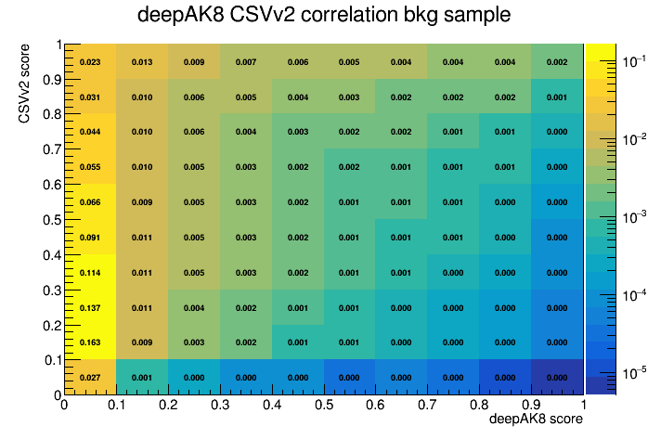
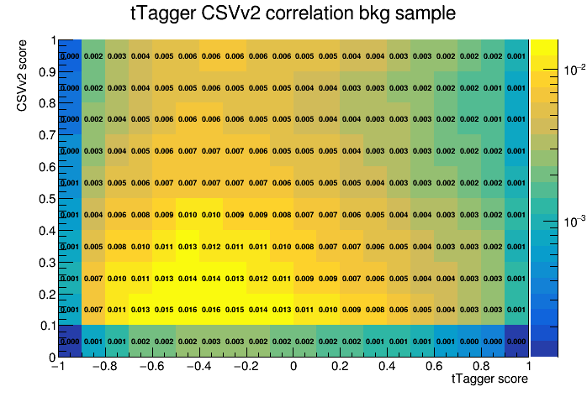
Btagging Correlation to DeepAK8 or TopTagger
deepAK8 b tagging correlation bkg sample
tTagger b tagging correlation bkg sample
b tagging score
b tagging score

Slide 38
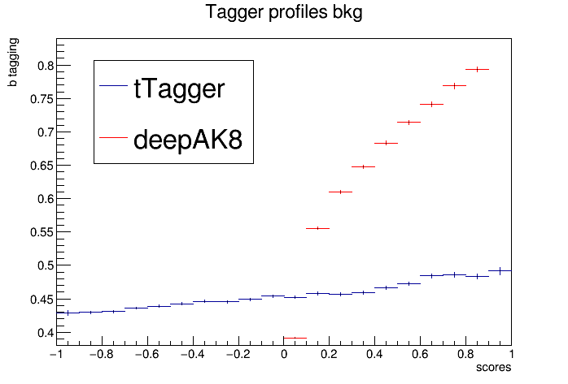
Btagging Correlation to DeepAK8 or TopTagger profiles
b-tagging mean value
vs
top tagging values

Slide 39
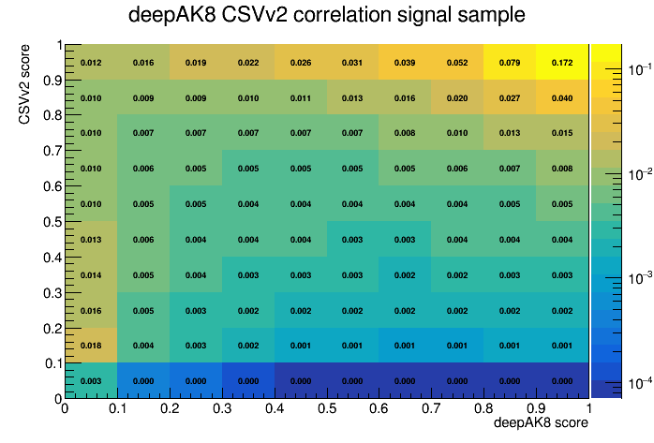
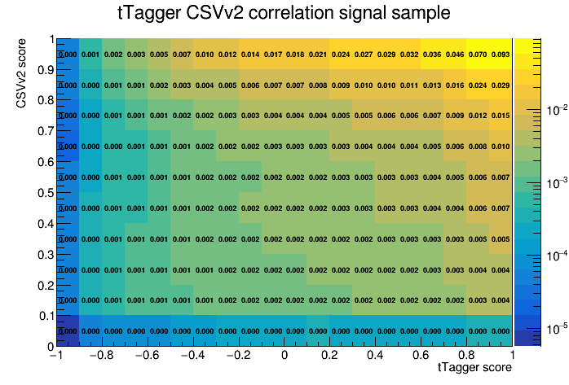
Btagging Correlation to DeepAK8 or TopTagger
deepAK8 b tagging correlation signal sample
tTagger b tagging correlation signal sample
b tagging score
b tagging score

Slide 40
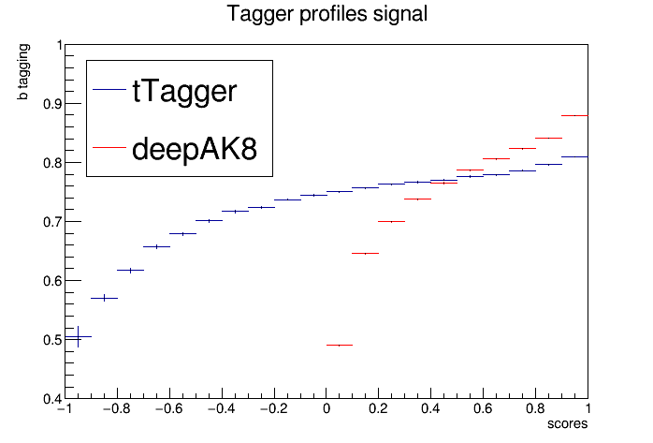
Btagging Correlation to DeepAK8 or TopTagger profiles
b-tagging mean value
vs
top tagging values

Slide 41
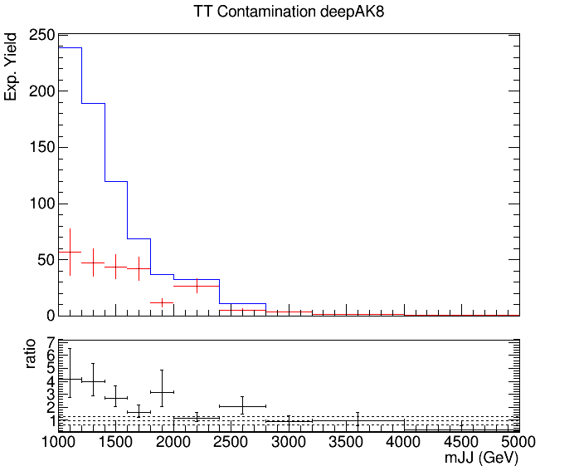
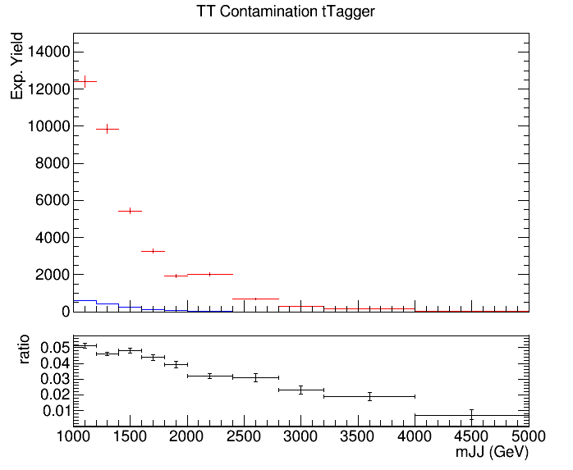
Control Region Contamination
Expected yield from QCD Bkg samples and TT Signal sample in the CR (btag == 0) vs mJJ
The QCD contribution is used to get the QCD shape
Control Region QCD sample
Control Region QCD sample
Control Region TT sample
Control Region TT sample

Slide 42
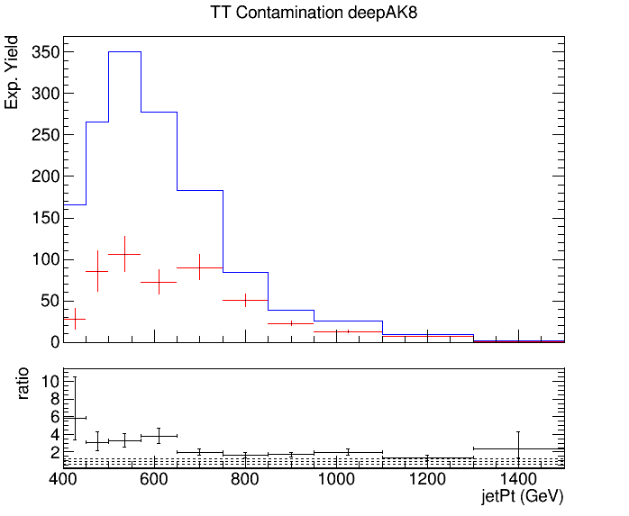
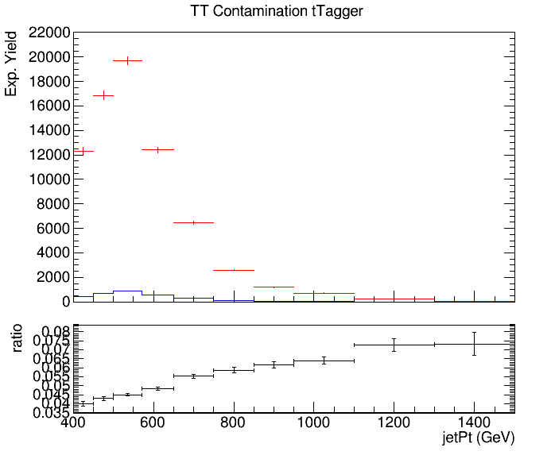
Control Region Contamination
Expected yield from QCD Bkg samples and TT Signal sample in the CR (btag == 0) vs jetPt
The QCD contribution is used to get the QCD shape
Control Region QCD sample
Control Region QCD sample
Control Region TT sample
Control Region TT sample

